Slide 1
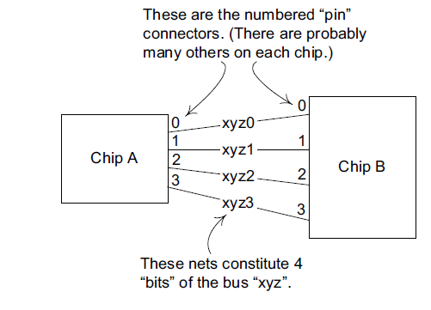

Slide 2
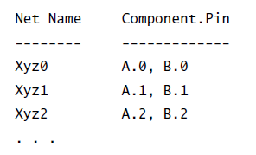
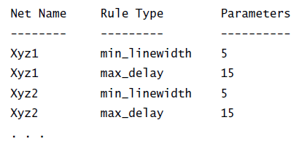
netspecification.txt
net_rules.txt

Slide 3

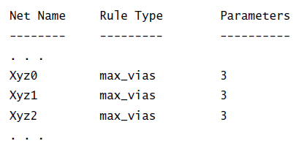
Neue Bus-Regel durch bus_rules.txt
Führt zu Ergänzungen in net_rules.txt

Slide 4
Neue Bus-Regel durch bus_rules.txt
1. Sort net list file by net name.
2. Read each line in file, seeking first one that starts with bus
name pattern.
3. For each line with matching name, parse line to get net name.
4. Append net name with rule text to rules file.
5. Repeat from 3 until left of line no longer matches bus name.
Führt zu Ergänzungen in net_rules.txt

Slide 5
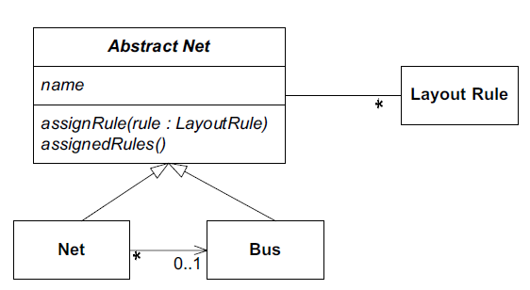
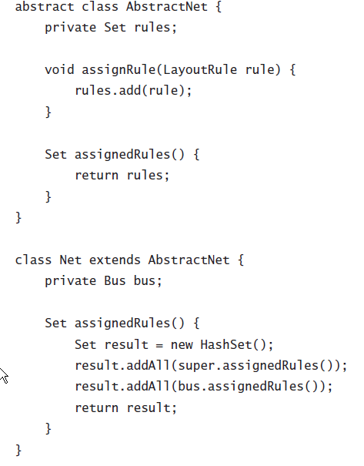

Slide 6
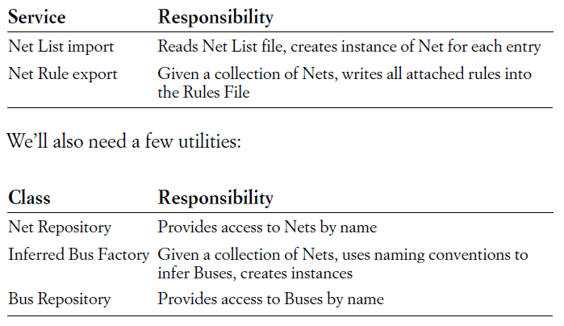

Slide 7
